Slide 1


Code Generation & Code Optimization By Prof. Londhe D. N Assistant Professor GIT, Lavel
GHARDA FOUNDATION’S
GHARDA INSTITUTE OF TECHNOLOGY, LAVEL
Department of Computer Engineering

Slide 2
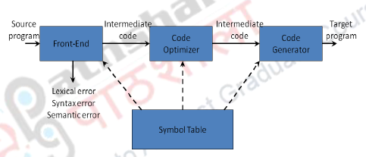
Code Generation – Introduction
Position of code generator

Slide 3
Expectations of the code generator
Code produced by compiler must be correct
Code produced by compiler should be of high quality
The code should be generated, by effectively using these target machine resources.

Slide 4
Issues in the Code Generator
1. Input to the code generator :
The code generator gets the three-address code as input.
The format in which this three-address code is fed as input need to be decided
Linear – postfix notation
Tables –Quadruples, triples, indirect triples
Non linear –Syntax Tree and DAG

Slide 5
In addition to the input, symbol table information need to be given to the code generator.

Slide 6
2. Target Program Code:
The back-end code generator of a compiler may generate different forms of code, depending on the requirements
The target program code needs to be specified as assembly language or machine language.

Slide 7
The following are some of the forms
Absolute machine code – This code is directly executable
Relocatable machine code – This is a re-locatable machine language and is normally available as an object files.
Assembly language – This is available in any assembly language which depends on the target machine and later an assembler converts this to machine language.

Slide 8
Byte code forms for interpreters – Java virtual machine has the write once and run anywhere concept where the output should be in Byte code.

Slide 9
3.Target Machine
Implementing code generation requires thorough understanding of the target machine architecture and its instruction set.
Consider a hypothetical machine with the following features:
The instructions are byte-addressable where a word is 4 bytes
Has n general purpose registers R0, R1, …, Rn-1

Slide 10
Instructions are of Two-address, ones of the form
op source, destination
where op stands for op-codes.
For example
MOV (move content of source to destination)
ADD (add content of source to destination)
SUB (subtract content of source from destination)

Slide 11
It is also assumed that the hypothetical target Machine supports the addressing modes as given
Mode | Form | Address | Added Cost
Absolute | M | M | 1
Register | R | R | 0
Indexed | c(R) | (c+contents(R)) | 1
Indirect register | *R | contents(R) | 0
Indirect indexed | *c(R) | contents(c+contents(R)) | 1
Literal | #c | N/A | 1

Slide 12
4. Instruction Selection
After understanding the types of addressing modes, the choice of an instruction depends on the cost effectiveness of the instruction
The cost of an instruction is defined as :
1 + cost(source-mode) + cost(destination-mode)

Slide 13
Example instruction costs
Instruction | Operation | Cost
MOV R0,R1 | Store content(R0) into register R1 | 1
MOV R0,M | Store content(R0) into memory location M | 2
MOV M,R0 | Store content(M) into register R0 | 2
MOV 4(R0),M | Store (4+contents(R0)) into M | 3
MOV *4(R0),M | Store contents(contents(4+contents(R0))) into M | 3
MOV #1,R0 | Store 1 into R0 | 2
ADD 4(R0),*12(R1) | Add (4+contents(R0)) to content((12+contents(R1))) | 3

Slide 14
Instruction selection is important to obtain efficient code. Suppose we need to translate the following three-address code
x:=y+z
The procedure is to move the value ‘y’ into a register and add with that register the value ‘z’ and store the result back in the variable ‘x’.

Slide 15
The following would be the instructions with a total cost of 6 (2+2+2):
MOV y,R0
ADD z,R0
MOV R0,x

Slide 16
Consider another instruction a:=a+1 and if we adopt the same strategy to convert this instruction to target code, the following would be the result with a cost of 6 (2+2+2)
MOV a,R0
ADD #1,R0
MOV R0,a

Slide 17
If we replace this with the following instruction, the cost would be 3 (1 + 1 +1) which is “1” each for ADD, #1, a
ADD #1,a
On the other hand, if this is replaced by the following instruction the cost would be 2 (1 for INC and 1 for “a”)
INC a

Slide 18
The choice of instructions also could change based on the addressing Modes
Suppose we translate a:=b + c into
MOV b,R0
ADD c,R0
MOV R0,a
The cost of this would be 6 (2 + 2 +2)

Slide 19
On the other hand, assuming addresses of a, b, and c are stored in R0, R1, and R2
MOV *R1,*R0
ADD *R2,*R0
The cost of this would be 2 (1 +1) which is just due to the MOV and ADD instructions

Slide 20
Consider, R1 and R2 contain values of b and c
ADD R2,R1
MOV R1,a
Would incur a cost of 3 (1 + 2) for ADD, MOV.

Slide 21
5. Need for Global Code optimization
This is the next issue in code generation. Consider the instruction and its corresponding three-address code as given in the table
Instruction | Code
x:= y + z | MOV y, R0 ADD z, R0 MOV R0, x

Slide 22
Consider the following sequence of instructions and supposing we use the same logic to translate, then we will end up in the table

Slide 23
Instruction | Code
a:= b + c | MOV b, R0 ADD c, R0 MOV R0, a
d:= a + e | MOV a, R0 --------- Redundant as R0 is used ADD e, R0 MOV R0, d
register R0 already had the value of ‘a’ according to the previous computation and hence this MOV instruction as indicated is redundant and this calls for Global code optimization.

Slide 24
6.Register allocation and Assignment
Register allocation to select the set of variables that will reside in registers at a point in the code
Register assignment to pick the specific register that a variable will reside in

Slide 25
Examples
Instructions | Code | Inference
t := a + b t := t * c t := t / d | MOV a, R1 ADD b, R1 MUL c, R1 DIV d, R1 MOV R1, t | Only R1 is used for generating code
t:= a * b t:= t + a t:= t / d | MOV a, R0 MOV R0, R1 MUL b, R1 ADD R0, R1 DIV d, R1 MOV R1, t | Two registers are used for almost the same sequence of instructions

Slide 26
7.Choice of Evaluation order
When instructions are independent, their evaluation order can be changed to utilize registers and save on instruction cost.
Consider the following instruction:
a + b -( c + d ) * e
The three-address code, the corresponding code and its reordered instruction are given in Table

Slide 27
Three-address code | Code | Reordered three-address code | Code
t1:=a+b t2:=c+d t3:=e*t2 t4:=t1-t3 | MOV a,R0 ADD b,R0 MOV R0,t1 MOV c,R1 ADD d,R1 MOV e,R0 MUL R1,R0 MOV t1,R1 SUB R0,R1 MOV R1,t4 | t2:=c+d t3:=e*t2 t1:=a+b t4:=t1-t3 | MOV c,R0 ADD d,R0 MOV e,R1 MUL R0,R1 MOV a,R0 ADD b,R0 SUB R1,R0 MOV R0,t4
The reordered instructions reduced the number of final code by 2 and thus saved in cost. The three-address code is reordered so that t1 is computed after computing t2 and t3. This reordering has saved in the instruction cost. The methodology to reorder instructions will be discussed in subsequent modules

Slide 28
Basic Blocks and Flow graphs
To handle all the issues in the code generation process, we need to construct basic blocks and flow graphs from the sequence of three-address code.
Basic blocks are computation sequences and they form the node of a flow graph.
Flow graph is a graphical representation of three-address code where nodes are the basic blocks and edges indicate the flow of control between basic blocks.

Slide 29
The primary objective of flow graphs is code optimization include optimal register allocation.
A flow graph is a graphical depiction of a sequence of instructions.
A flow graph can be defined at the intermediate code level or target code level.

Slide 30
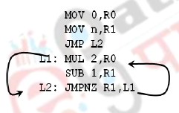
For Example
MOV 1,R0
MOV n,R1
JMP L2
L1: MUL 2,R0
SUB 1,R1
L2: JMPNZ R1,L1
Flow Graph

Slide 31
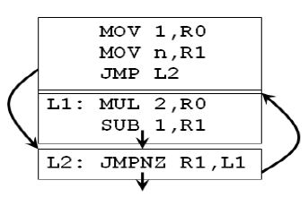
A basic block is a sequence of consecutive instructions with exactly one entry point and one exit point (with natural flow or a branch instruction).
Flow graph with basic blocks highlighted

Slide 32
In a flow graph, suppose there is an edge from basic block B1 to B2 as B1→B2, then B1 is a predecessor of B2 and B2 is a successor of B1

Slide 33
The algorithm for basic block construction
Input: A sequence of three-address statements
Output: A list of basic blocks with each three-address statement in exactly one block
1. Determine the set of leaders, the first statements of basic blocks
a) The first statement is the leader
b) Any statement that is the target of a goto or conditional goto is a leader
c) Any statement that immediately follows a goto or conditional goto is a leader
2. For each leader, its basic block consist of the leader and all statements up to but not including the next leader or the end of the program

Slide 34
For Example
1. prod := 0
2. i := 1
3. t1 := 4 * i
4. t2 := a[t1]
5. t3 := 4 * i
6. t4 := b [t3]
7. t5 := t2 *t4
8. t6 := prod + t5
9. prod := t6
10. t7 := i+1
11. i := t7
12. If i<= 20 goto (3)

Slide 35
To construct the basic block and flow graph the following are the observations:
Line (1) is the beginning of the three-address code and hence is declared as a leader
• Line (3) is the target of a jump from line (12) and hence is also declared a leader
• Statement following (12), say line number (13) is a leader
• Hence, Lines (1) and (2) will form a basic block
• Lines (3) to (12) will form another basic block.

Slide 36
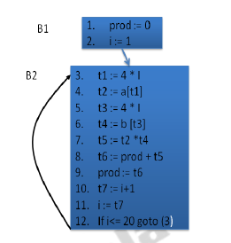

Slide 37
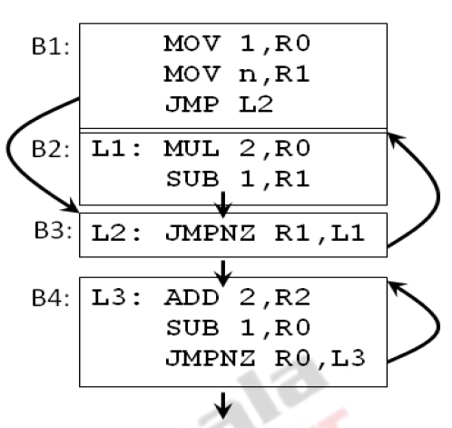
Loops

Slide 38
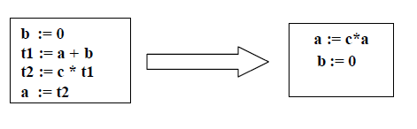
Transformations/Optimization on Basic Blocks
1. Equivalent Block Transformation:-Two basic blocks are equivalent if they compute the same set of expressions.

Slide 39
2. A code-improving transformation is a code optimization to improve speed or reduce code size.
3. Global transformations are performed across basic blocks.
4. Local transformations are only performed on single basic blocks.
The transformations that are carried out must be safe and preserve the meaning of the code.

Slide 40
We can say, that a local transformation is safe if the transformed basic block is guaranteed to be equivalent to its original form.
The transformations that are possible with basic block can be grouped into the following:
Structure-Preserving Transformation – In this transformation, the syntactic structure of the statements in the basic blocks are not altered

Slide 41
Algebraic Transformation–In this type of transformation, mathematical identity are applied on the statements to perform the transformation and thus altering the syntactic structure

Slide 42
Structure-Preserving Transformation
1. Common Sub-expression Elimination :-Within a block, if a particular expression is repeated the expression is said to be common. This could be eliminated to avoid unnecessary computation
If an expression is computed repeatedly and in between the repeated computations, if the values of the variables of the expression is unaltered then the expression is said to be common.

Slide 43
1. a := b + c
2. b := a – d
3. c := b + c
4. d := a - d
1. a := b+c
2. b := a – d
3. c := b + c
4. d := b

Slide 44
1. t1 := b * c
2. t2 := a - t1
3. t3 := b * c
4. t4 := t2 + t3
1. t1 := b * c
2. t2 := a - t1
3. t3 := t1
4. t4 := t2 + t3
1. t1 := b * c
2. t2 := a - t1
3. t4 := t2 + t1

Slide 45
2. Dead code elimination
Any code that is not used is said to be dead. In the previous example, t3 is dead and hence we eliminated the instruction t3:= t1.
In a similar fashion, if a particular variable is not going to be used later, then the instruction involving that variable could be eliminated.
Example
b := a + 1
a := b + c

Slide 46
If the variable ‘a’ is not going to be used in any part of the later set of instructions, then ‘a’ is said to be dead and hence the above sequence of instructions can be reduced to just the single statement:
b := a + 1
Unreachable code will also account for dead code and hence they could also be eliminated.

Slide 47
3. Renaming Temporary variables
Temporary variables that are dead at the end of a block can be safely renamed and can be eliminated if necessary. Consider the following sequence of instructions:
1. t1 := b + c
2. t2 := a - t1
3. t1 := t1 * d
4. d := t2 + t1

Slide 48
In this scenario, t1 is being reused at line numbers (1) and (3) and this could be conveniently renamed to another variable as shown in the instruction sequence below:
1. t1 := b + c
2. t2 := a - t1
3. t3 := t1 * d
4. d := t2 + t3
Here, t1 in the LHS of line (3) is renamed as t3 and this value is used at line number (4).

Slide 49
4. Independent statements can be reordered
For improving on the register usage, certain statements could be reordered. However, consider the following example
1. t1 := b + c
2. t2 := a - t1
3. t3 := t1 * d
4. d := t2 + t3
The above instructions could be changed as follows which doesn’t alter the syntactic and semantic structure of the computation.

Slide 50
1. t1 := b + c
2. t3 := t1 * d
3. t2 := a - t1
4. d := t2 + t3
Here, we have swapped line number (2) and (3) so that the computed value of t1 could be used effectively.

Slide 51
Algebraic transformations
In this transformation, the syntactic structure is altered to apply the mathematical identities.
t1 := a - a
t2 := b + t1
t3 := 2 * t2
x := y ** 2
t1 := 0
t2 := b
t3 := t2 << 1
x := y * y

Slide 52
Next-Use Information
Next-use information is needed for dead-code elimination and register allocation.
Next-use is computed by a backward scan of a basic block.
The next-use information will indicate the statement number at which a particular variable that is defined in the current position will be reused.

Slide 53
The following are the steps involved in generating next-use information:
Consider a statement number ‘i' with the following instruction.
i : x := y op z
We need to add liveness/next-use information for the variables x, y, and z to statement i using the following rules:

Slide 54
Set x to “not live” and “no next use” – As ‘x’ is defined here it’s set to not live
Set y and z to “live” and the next uses of y and z to i. The variables ‘y’ and ‘z’ are being used in this statement and hence has their next use at ‘i' and as they are used here these variables are set to live.

Slide 55
Simple Code Generator
Input: All basic blocks & next use information
We assume that for each operator in the input statement there is a target-language operator. It uses new function getreg() to assign registers to variables.
The algorithm for code generation initially checks if operands to three-address code are available in registers.

Slide 56
After computing the results of two operations, the results are kept in registers till the result is required by another computation
For example, consider the following instruction:
a := b + c
The following sequence would be followed by the code generator algorithm:

Slide 57
The algorithm initially checks if ‘b’ and ‘c’ are in registers Ri, Rj. If available then the instruction ADD Ri, Rj is generated and this costs 1 and the result is stored in Rj
• If ‘b’ alone is in register and ‘c’ is not in the register, then the instruction ADD c, Ri is generated to a cost of 2
• MOV Rj, a is issued to move the computation to ‘a’.

Slide 58
Data structures for the Simple code generator algorithm
This algorithm uses two data structures for generating code.
Register Descriptor : which is used to keep track of which variable is currently stored in a register at a particular point in the code.
Address descriptor :which is used to keep track of the location where the current value of the variable can be found at run time.

Slide 59

For example consider the following code:
MOV a, R0
after this instruction is executed, the register descriptor of R0 will have its contents column updated as ‘a’.

Slide 60
For the following sequence of code, the contents of register descriptor of R0 and R1 will be ‘a’. The contents of the address descriptor of the variable ‘a’ will read R0 and R1.
MOV a, R0
MOV R0, R1

Slide 61
The Code Generation Algorithm
Input : Sequence of 3-address statements from a basic block.
Output: Assembly language code
For each statement x := y op z
1. Set location L = getreg(y, z) to store the result of y op z
2.If y does not belong to L then generate MOV y’,L where y’ denotes one of the locations where the value of y is available - choose register if possible

Slide 62
3.Generate OP z’, L
where z’ is one of the locations of z; Update register/address descriptor of x to include L
4. If y and/or z has no next use and is stored in register, update register descriptors to remove y and/or z

Slide 63
Algorithm : getreg ( )
The function getreg returns the location L to hold the value of x for the assignment
x := y op z
Step 1: If y is stored in a register R and R only holds the value y, and y has no next use, then return R; Update address descriptor: value y no longer in R
Step 2: Else, return a new empty register if available

Slide 64
Step 3: Else, find an occupied register R; Store contents (register spill) by generating MOV R, M for every M in address descriptor of the variable; Return register R
Step 4: Return the memory location of x as L.

Slide 65
Example
d := (a-b) + (a-c) + (a-c)
The corresponding three- address code will be the following, where t, u, v, are temporary variables.
t: = a-b
u := a-c
v := t + u
d := v +u

Slide 66
Statements | Code Generated | Register Descriptor | Address Descriptor
t := a - b | MOV a, R0 SUB b, R0 | Registers empty R0 contains t | t in R0
u := a - c | MOV a, R1 SUB c, R1 | R0 contains t R1 contains u | t in R0 u in R1
v := t + u | ADD R1, R0 | R0 contains v R1 contains u | u in R1 v in R0
d := v + u | ADD R1, R0 MOV R0, d | R0 contains d | d in R0 d in R0 and memory

Slide 67
DAG Construction
Directed Acyclic Graph – DAG
DAG is a useful data structure for representing the basic blocks.
DAG can be very useful in identifying and implementing structure preserving and algebraic transformation on basic blocks.
DAG gives all the necessary details of how the value is computed for each statement of the basic block.

Slide 68
Applications of DAG
Identifying common sub-expressions in a basic block.
variables which are defined inside the block but evaluated outside and which statements of a block gets their value computed outside the block.

Slide 69
DAG construction
A DAG is typically constructed for each basic block
A DAG is a directed acyclic graph and thus has nodes and edges.
Leaves are labeled by unique identifiers such as variable or constants of the three-address instruction
Interior nodes are labeled by an operator.

Slide 70
Algorithm: DAG construction
Input: Basic block
Output: DAG having label for each node – operator or variables. For each node a list of attached identifiers

Slide 71
DAG_Construct( )
{
1. x := y op z ………………………….(i)
2. x := op y …………………………….(ii)
3. x := y ………………………………….(iii)
4. If node (y) is undefined create a label ‘y’ and let it be node (y) and so for node (z) if ‘z’ is not there
5. In case (i) check if there is a node labeled ‘op’ whose left and right children are ‘y’ and ‘z’ respectively. If not create such a node and let it be ‘n’. In case (ii) ignore ‘z’ and do the same thing. In case (iii) let the node(y) be ‘n’
6. Delete x from the list of attached identifiers for node(x). Append ‘x’ to the list of attached identifiers for the node ‘n’ and set node(x) to n
}

Slide 72
Consider the following example involving three-address code instructions:
1. t1 := 4 * i
2. t2 := a[t1]
3. t3 := 4 * i
4. t4 := b [t3]
5. t5 := t2 *t4

Slide 73
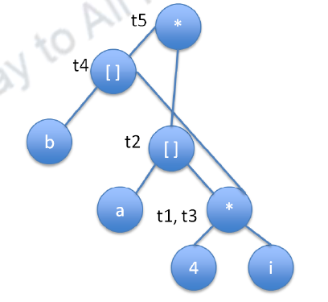
DAG constructed for the example

Slide 74
Peephole Optimization
This is code optimization Technique
We can apply Pheephole optimazation either on target code or intermediate code.
This optimization technique try to improve the performance of target code by
Examine a short sequence of target instructions (called the peephole)
Replace these instructions by a shorter or faster sequence, whenever possible.

Slide 75
Program transformation that are characterestics of Peephole optimazation
Redundant – instruction elimination
Flow- of – control optimizations
Algebraic simplifications
Use of machine idioms

Slide 76
Rudundant Loads and Stores
If we see the instruction sequence
MOV R0, a
MOV a, RO
We can delete instruction (2) because whenever (2) is executed, (1) will ensure that the value of a is already in register R0.

Slide 77
Note that if (2) had a label we could not be sure that (1) was always executed immmediately before (2) and so we could not remove (2).
Another way, (1) and (2) have to be in the same basic block for this transformation to be safe.

Slide 78
Unreachable Code
Another opportunity for peephole optimization is the removal of unreachable instructions.
An unlabeld instruction immediately follwoing an unconditional jump may be removed.
This peration can be repeated to eliminate a sequence of instructions.

Slide 80
Flow – of – Control Optimizations
The intermediate code generation algorithms frequently produce jumps to jumps, jumps to conditional jumps, or conditional jumps to jumps.
These unnecessary jumps can be eliminated in either the intermediate code or the target code by the following types of peephole optimizations.

Slide 81
Example
goto L1
...
L1: goto L2
Can be replace by
goto L2
...
L1: goto L2

Slide 82
If there are now no jumps to L1, then it may be possible to eliminate the statement L1: goto L2
if a<b goto L1
....
L1: goto L2
Can be replaced by

Slide 83
if a<b goto L2
....
L1: goto L2

Slide 84
goto L1
...
L1: if a<b goto L2
L3:
May be replaced by
if a<b goto L2
goto L3
....
L3:

Slide 85
Algebraic simplification
Statement such as
x = x+0 or x = x + 1
Are often produced by straightforward intermediate code-generation algorithms, and they can be eliminated easily through peephole optimization.

Slide 86
Reduction in Strength
Reduction in strength replaces expensive operations by equivalent cheaper ones on the target machine.
Example. X^2 is cheaper to implement as x*x than call to an exponentiation routine.

Slide 87
Use of Machine Idioms
The target machine may have hardware instructions to implements certain specific operations effectively.
Use of these instructions can reduce execution time.
Example. Some machine have auto increments and auto decrement addressing modes.
The use of these modes greatly improves the quality of code when pushing or popping a stack

Slide 88
These modes can also be used in code for statements like i := i+1

Slide 89


